Slide 1

Python Map vs Tensorflow Map - map vs tf.map_fn

Slide 2
Reference
Youtube on lambda, filter, map, reduce
Youtube on Several Graphs
Youtube
Code

Slide 3
Task

Slide 4

Given
[1, 2, 3, 4]
Task
[1**2, 2**2, 3**3, 4**2]

Slide 5
Given
[1, 2, 3, 4]
Task
[1**2, 2**2, 3**3, 4**2]

Slide 6
for loop

Slide 7
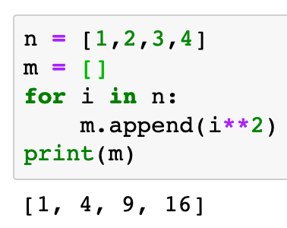

Slide 8
list comprehension

Slide 9
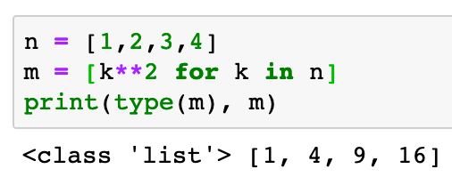

Slide 10
numpy array

Slide 11
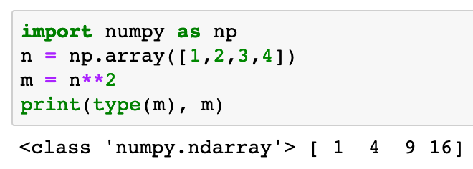

Slide 12
map

Slide 13
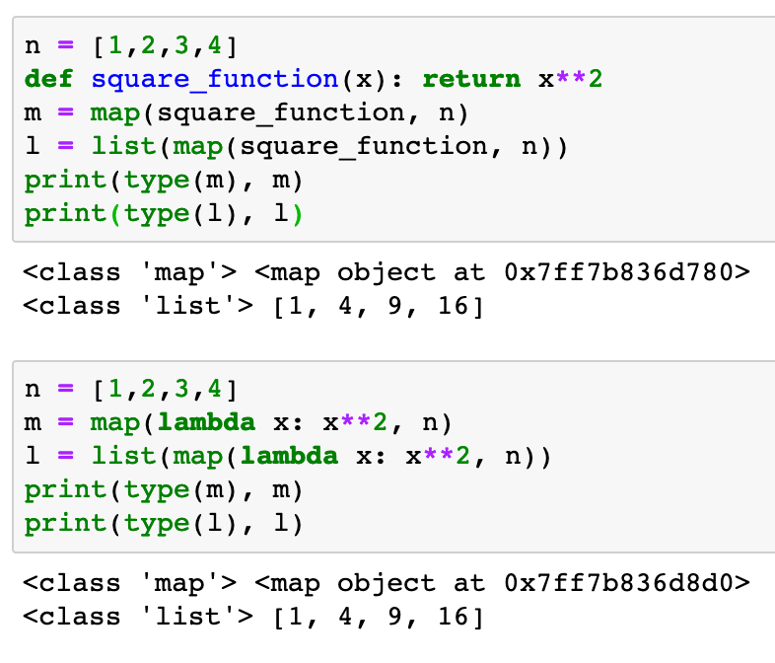

Slide 15
tf.map_fn

Slide 16
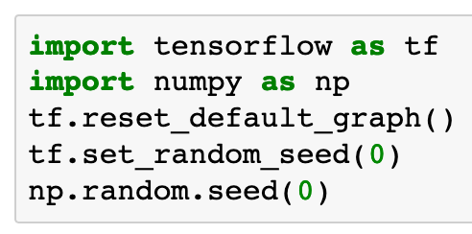

Slide 17
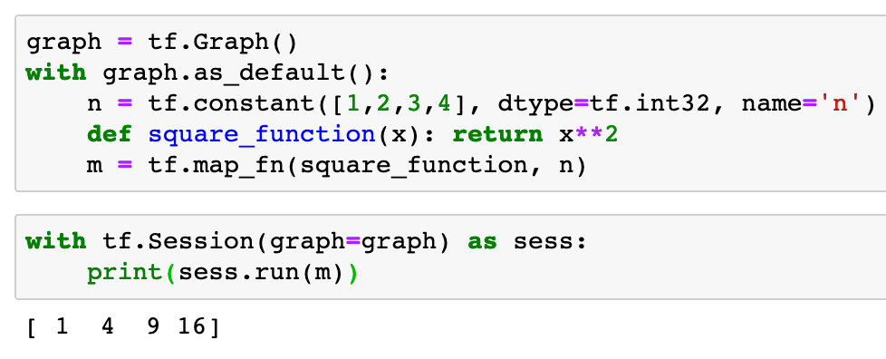

Slide 19
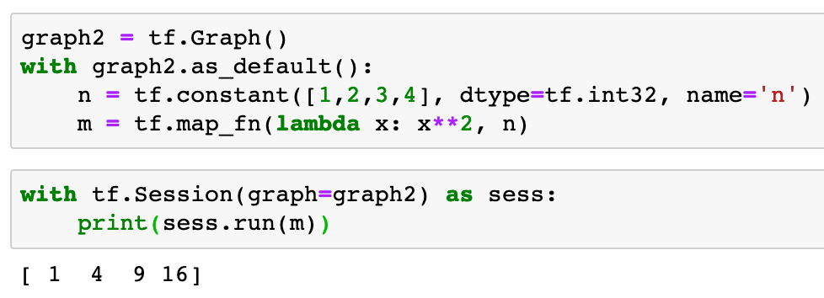

Slide 21
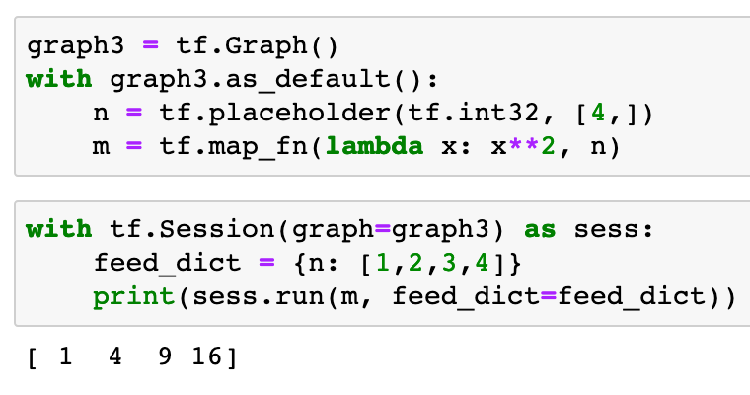

Slide 23
Bonus

Slide 24
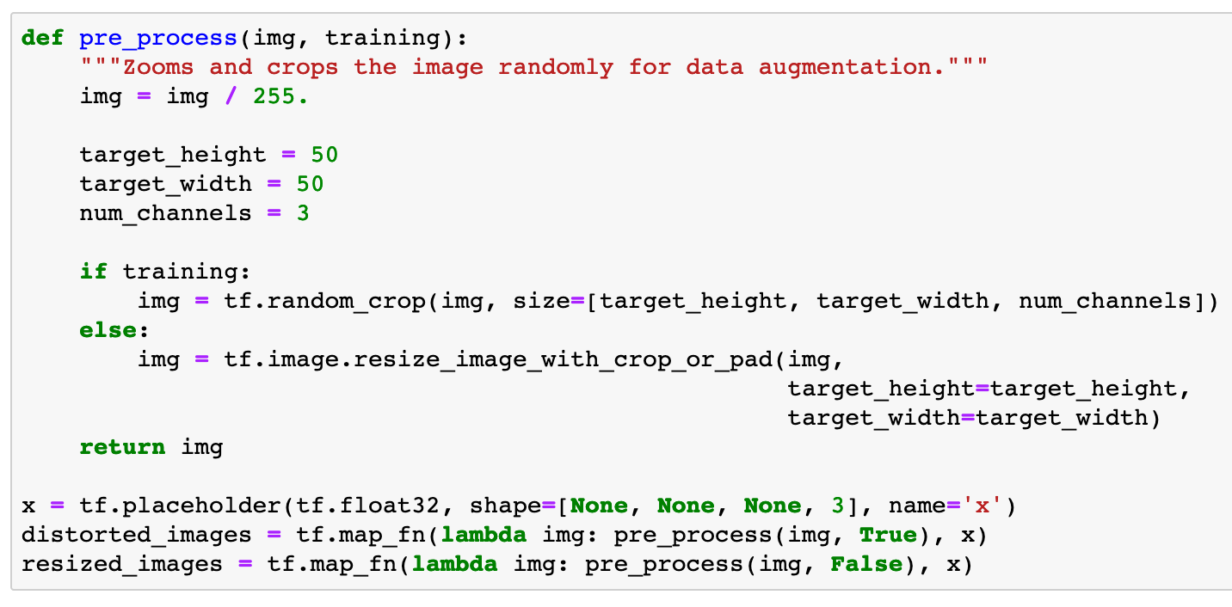

Slide 25
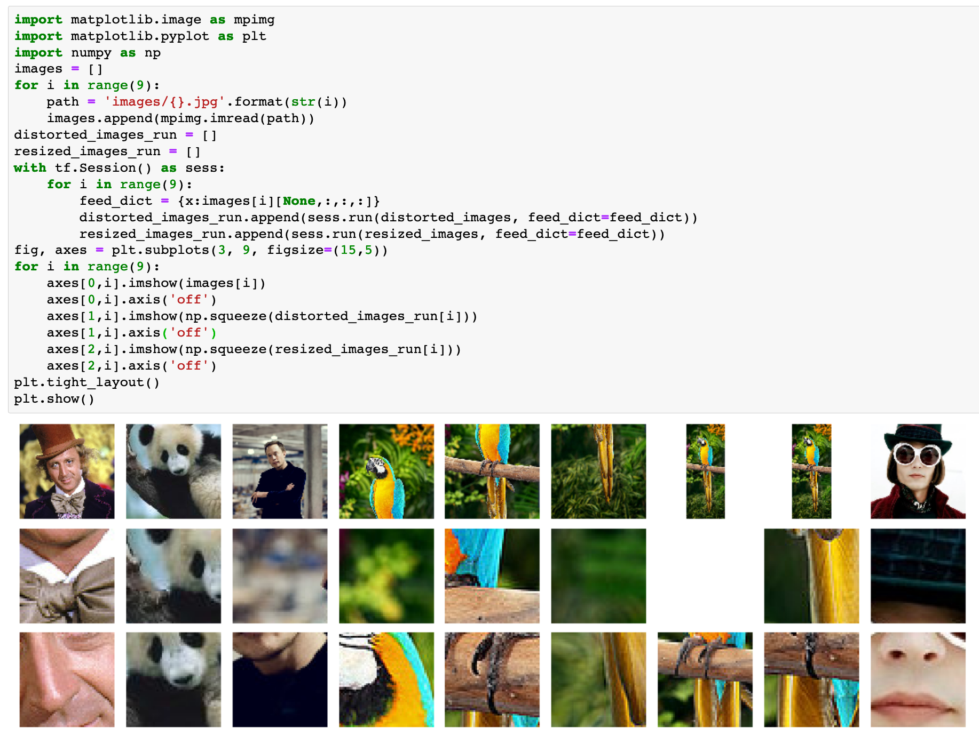

Slide 26
Now
Let’s Play with Code

